Slide 1
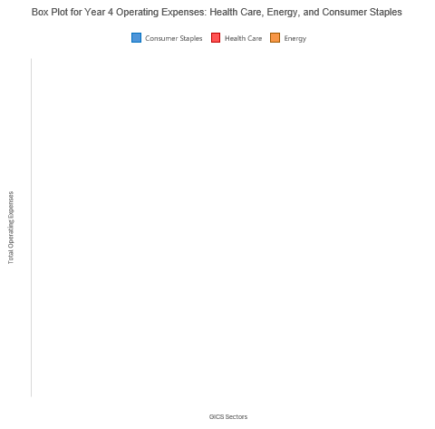
Question: How do the summary statistics for Total Operating Expenses in Year 4 compare across the Health Care, Energy, and Consumer Staples sectors, and what do they reveal about variability, central tendencies, and the presence of outliers within each sector?
Here are a Box plots representing the distribution of Total Operating Expenses for all companies within the Health Care, Energy, and Consumer Staples sectors in Year 4, illustrating differences and trends in spending across these sectors.
Range and IQR Analysis:
Examining the range in Year 4, we observe that the maximum values for Consumer Staples at $97,041,000,000 surpass those of Energy at $79,492,000,000, and Healthcare at $54,872,000,000. This suggests a broader spread in the potential operating expenses in the Consumer Staples sector.
The Inter Quartile Range (IQR) for Health Care is $6,434,200,000, for Energy is $5,288,964,000, and for Consumer Staples is $5,123,400,000. Despite the largest maximum value, Consumer Staples shares a comparable IQR with the other sectors, indicating a similar concentration of data points around the median.
Central Tendencies and Variability:
Focusing on central tendencies, the mean operating expense of Energy is the highest at $8,239,515,645, followed by Consumer Staples at $7,405,715,970, and Healthcare at $6,411,356,681. The medians reflect a similar hierarchy but are generally lower than the means, which is indicative of positively skewed distributions across all sectors. Skewness measures show Energy at 3.66, slightly lower than Healthcare's 3.554 and significantly lower than Consumer Staples' 4.76, indicating a heavier tail on the right side for Consumer Staples.
Dispersion and Outliers:
In terms of dispersion, the standard deviation is highest in Consumer Staples at $16,911,444,755, followed by Energy at $15,381,387,193 and Healthcare at $9,278,573,766. These figures suggest greater variability in the Consumer Staples and Energy sectors compared to Healthcare.
Kurtosis values are highest for Consumer Staples at 24.75, indicating a more peaked distribution with thicker tails, compared to Energy at 14.92 and Healthcare at 15.63. This points to a higher likelihood of outliers in the Consumer Staples sector, which could reflect extreme values in operating expenses.

Slide 2
Displayed here are bar plots (or histograms) representing the distribution of Total Operating Expenses for each company within the Health Care, Energy, and Consumer Staples sectors. These visualizations provide a comprehensive view of how operating expenses are spread across different companies within each sector. Summary statistics for all sectors have also been included below.
Summary Statistics
Category | Health Care | Energy | Consumer Staples
Min | $ - | $ 228,000,000 | $ -
Q1 | $ 1,233,800,000 | $ 1,199,000,000 | $ 1,355,600,000
Median | $ 3,229,992,000 | $ 2,687,000,000 | $ 2,209,400,000
Q3 | $ 7,668,000,000 | $ 6,487,964,000 | $ 6,479,000,000
Max | $ 54,872,000,000 | $ 79,492,000,000 | $ 97,041,000,000
Standard Deviation | 9278573766 | 15381387193 | 16911444755
Mean | $ 6,411,356,681 | $ 8,239,515,645 | $ 7,405,715,970
Skewness | 3.554317547 | 3.66 | 4.76
Kurtosis | 15.6301641 | 14.92 | 24.75
Conclusion: Reviewing the summary statistics Box plot and Bar plots for Year 4, we can conclude that while there is a significant overlap in the distribution characteristics of Energy and Consumer Staples, the distribution of Healthcare stands distinct, primarily in terms of its lower variability and milder outliers.

Slide 3
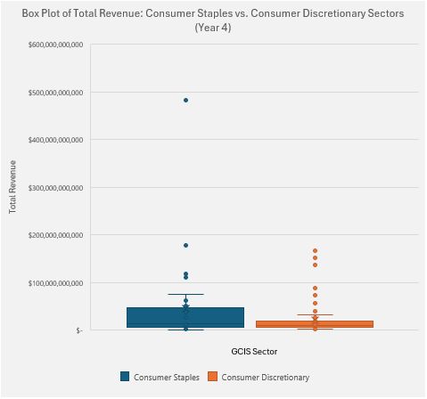
Question: Does the Total Revenue of Consumer Staples sector differ significantly from those in the Consumer Discretionary sector in Year 4?
Box plots have been created to display the distribution of Total Revenue for all companies within the Consumer Staples and Consumer Discretionary sectors for Year 4, highlighting differences and variability in revenue across these sectors.
Range and IQR Analysis:
Beginning with the range, we see that the maximum total revenue for the Consumer Staples Sector ($482,130,000,000) significantly exceeds the maximum total revenue of the Consumer Discretionary Sector ($166,380,000,000). On the contrary, the minimum total revenue for the Consumer Staples Sector ($99,642,000) is significantly lower than the minimum total revenue of the Consumer Discretionary Sector ($1,492,000,000). This amounts to a wider range in Consumer Staples sector as compared to the Consumer Discretionary sector.
The Inter Quartile Range (IQR) for Healthcare is $6,434,200,000, for Energy is $5,288,964,000, and for Consumer Staples is $5,123,400,000. Despite the largest maximum value, Consumer Staples shares a comparable IQR with the other sectors, indicating a similar concentration of data points around the median.
Central Tendencies and Variability:
Focusing on central tendencies, the mean operating expense of Energy is the highest at $8,239,515,645, followed by Consumer Staples at $7,405,715,970, and Healthcare at $6,411,356,681. The medians reflect a similar hierarchy but are generally lower than the means, which is indicative of positively skewed distributions across all sectors. Skewness measures show Energy at 3.66, slightly lower than Healthcare's 3.554 and significantly lower than Consumer Staples' 4.76, indicating a more pronounced tail on the right side for Consumer Staples.
Dispersion and Outliers:
In terms of dispersion, the standard deviation is highest in Consumer Staples at $16,911,444,755, followed by Energy at $15,381,387,193 and Healthcare at $9,278,573,766. These figures suggest greater variability in the Consumer Staples and Energy sectors compared to Healthcare.
Kurtosis values are highest for Consumer Staples at 24.75, indicating a more peaked distribution with heavier tails, compared to Energy at 14.92 and Healthcare at 15.63. This can be attributed to a higher likelihood of outliers in the Consumer Staples sector, which could reflect extreme values in Total Revenue

Slide 4
Here is a clustered Bar plot to represent the distributions of the Consumer Staples and Consumer Discretionary sectors side by side. Also included is a table featuring summary statistics of both sectors.
Summary Statistics
 | Consumer Staples | Consumer Discretionary
Number of companies | 33 | 76
Min | $ 99,642,000 | $ 1,492,000,000
Q1 | $ 6,100,500,000 | $ 6,077,776,000
Median | $ 13,525,000,000 | $ 10,186,347,000
Q3 | $ 47,330,459,500 | $ 47,330,459,500
Max | $ 482,130,000,000 | $ 166,380,000,000
Mean | $ 44,215,178,848 | $ 20,050,682,947
Standard Deviation | 86,896,247,341 | 30,773,667,578
Skewness | 4.16693 | 3.43213
Kurtosis | 19.8141664 | 12.19388597
Conclusion: Reviewing the summary statistics and visual data, we can conclude that there are significant differences in the revenue characteristics between the Consumer Staples and Consumer Discretionary sectors.

